Slide 1
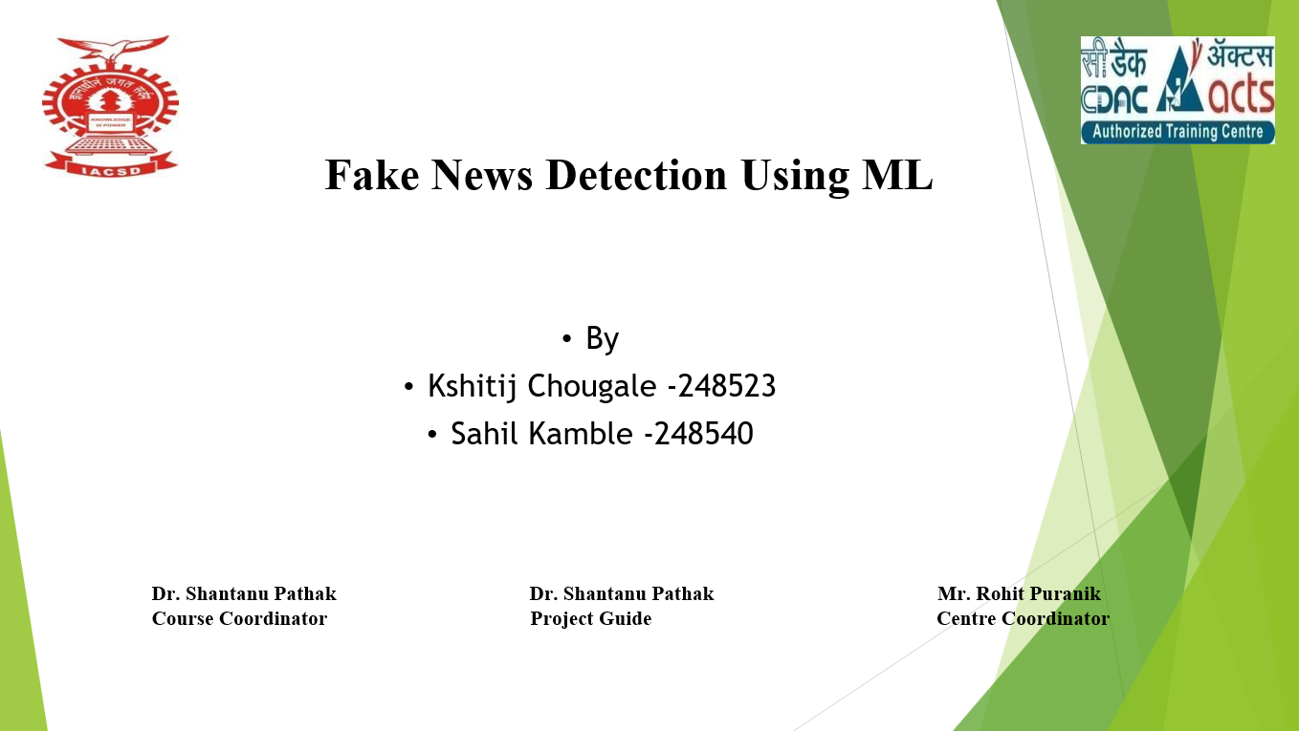

Slide 2




Introduction
Fake news is a growing problem that misleads people and spreads false information. It can change public opinions and reduce trust in real news. This project aims to solve this issue by using machine learning to detect fake news accurately.
Information Integrity
Combating Disinformation
Technological Solution
Making sure news is real and trustworthy.
Stopping the spread of fake news.
Using machine learning to detect fake news automatically.

Slide 3
Data Collection: True and Fake News Datasets
True News Dataset
Fake News Dataset
Sourced from reliable news outlets. Articles labeled as factual and verified.
Collected from unreliable websites and social media. Articles flagged as deceptive.
We used two distinct datasets. Our true news dataset contains articles from trusted sources. The fake news dataset contains deceptive articles.

Slide 4
Data Preprocessing
Raw data requires careful preprocessing. This involves cleaning, tokenization, and normalization. Techniques like removing stop words and stemming are applied. Preprocessing ensures quality for effective model training.
1
Cleaning
2
Tokenization
3
Normalization
Removing irrelevant characters.
Splitting text into individual words or tokens.
Converting text to a standard format.

Slide 5
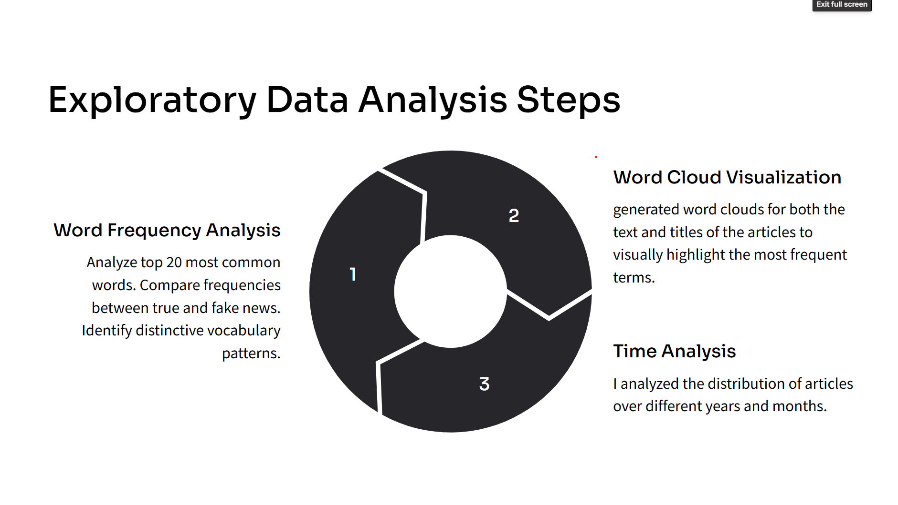

Slide 6
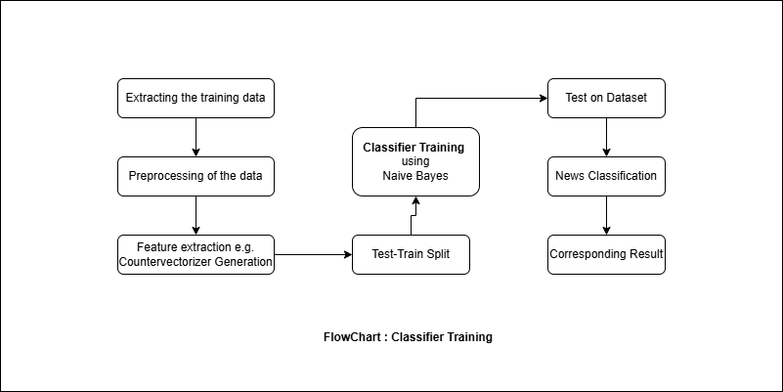

Slide 7
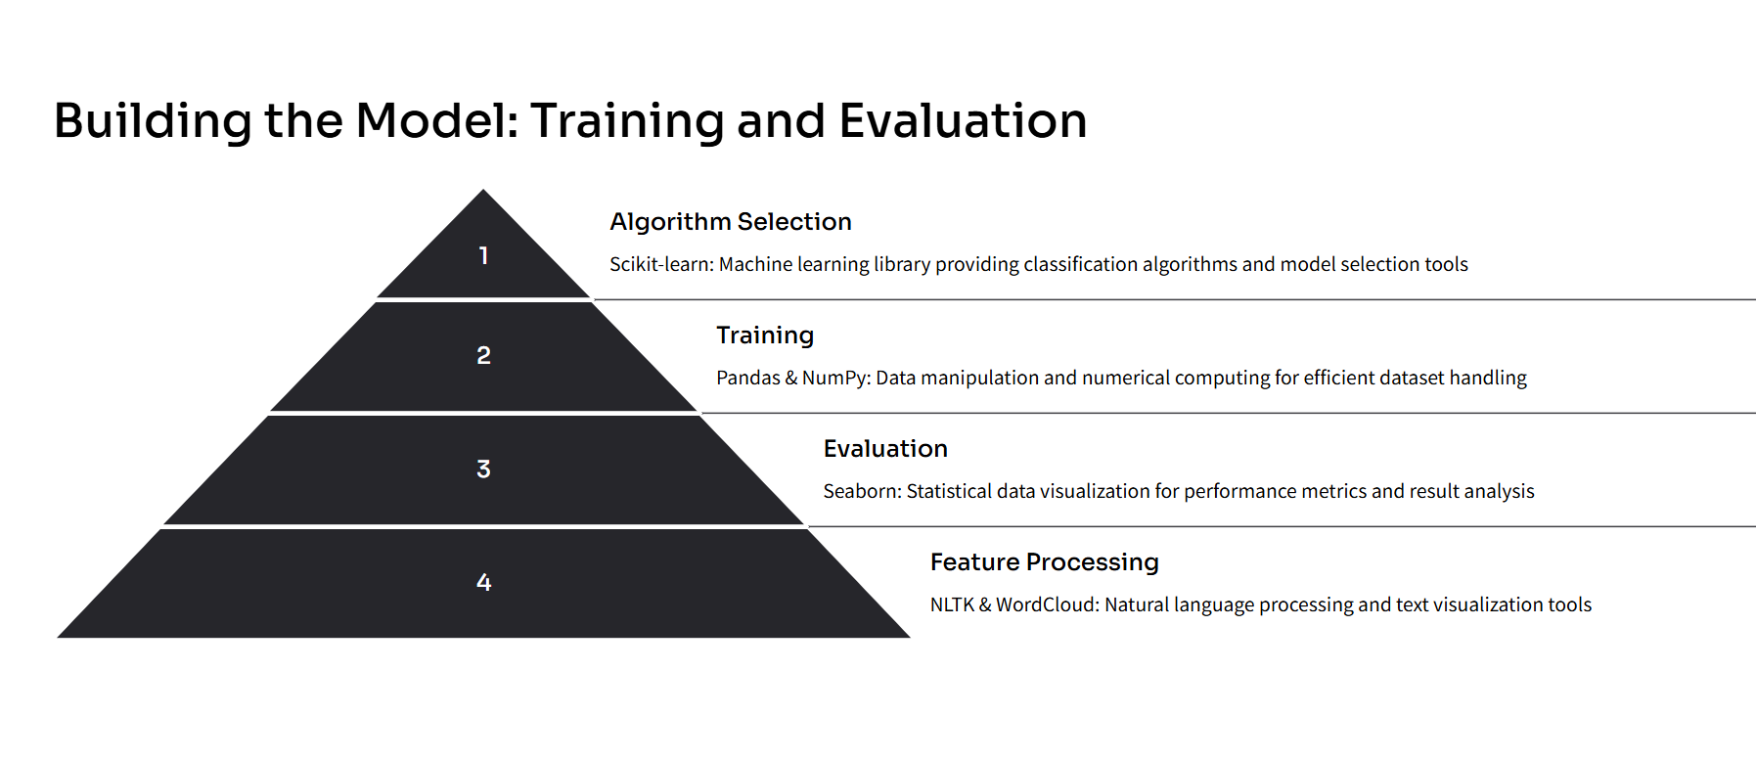

Slide 8
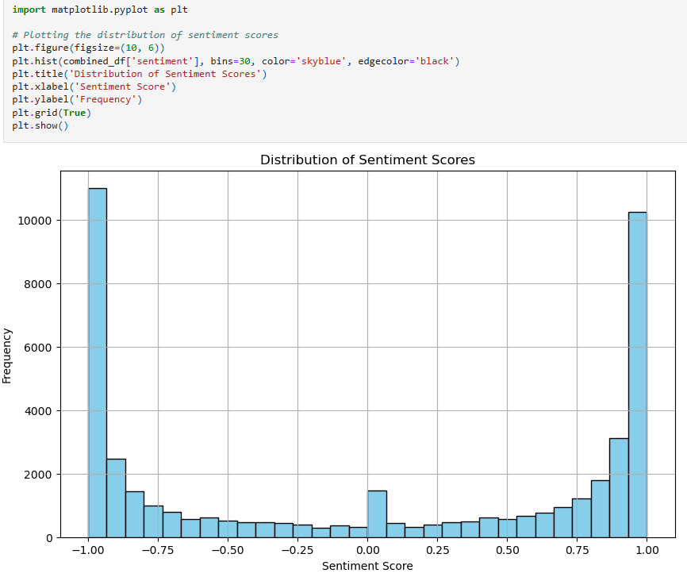
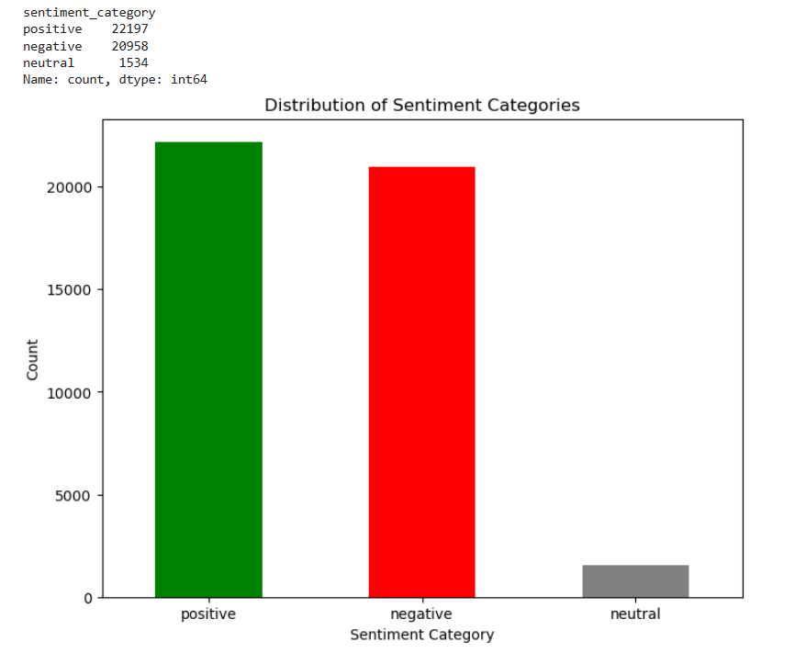
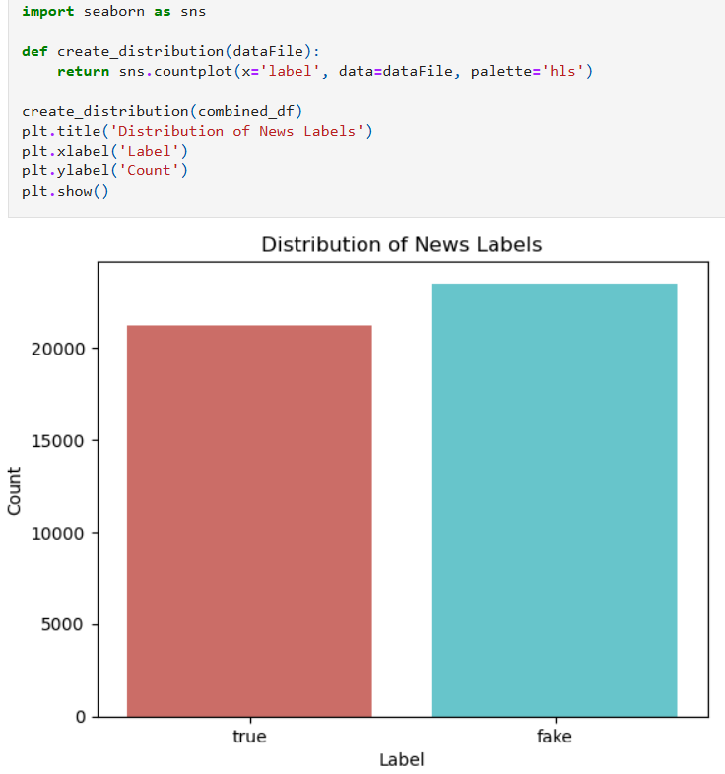
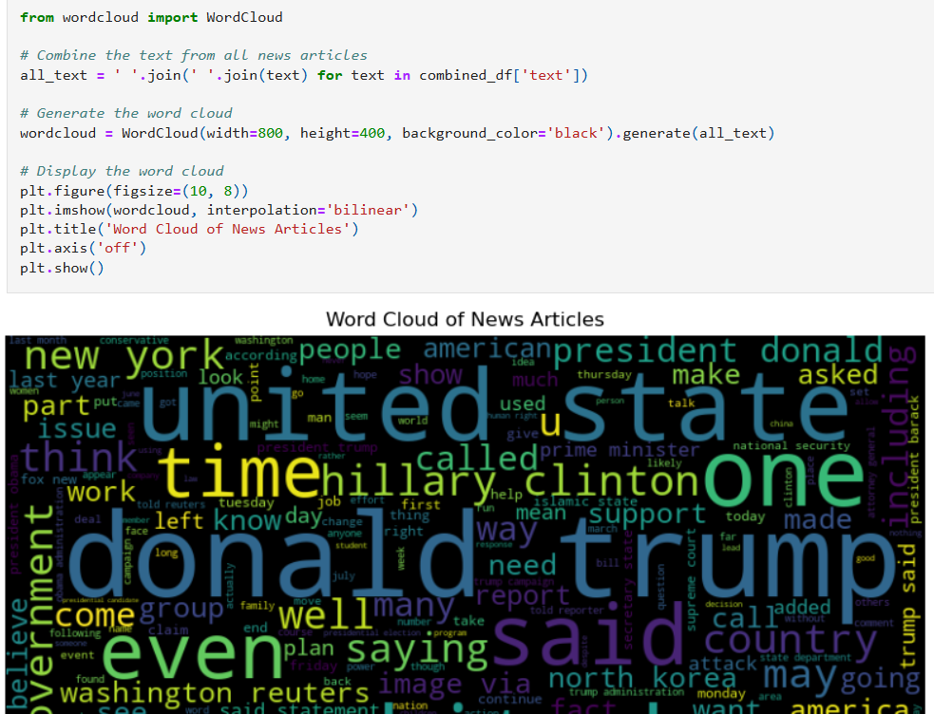

Slide 9
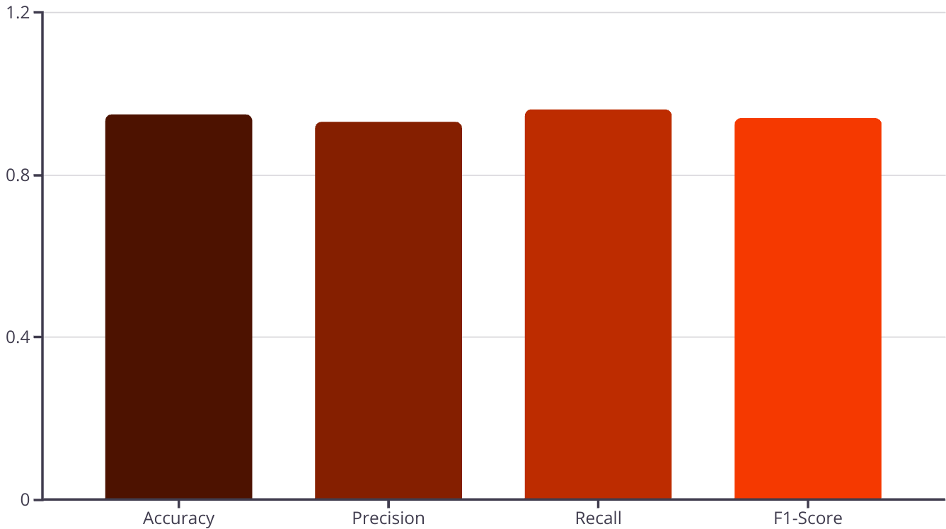
Model Evaluation
The trained model is evaluated using a held-out test set. Metrics such as accuracy, precision, recall, and F1-score are calculated. These metrics determine the model's effectiveness. Evaluation ensures the model generalizes well to unseen data.

Slide 10
Conclusion
Accuracy
Challenges
Machine learning models effectively distinguish fake news. Our approach can be accurate.
Fake news detection remains tough. Continuous improvement and adaptation are needed.
Fake news detection uses machine learning. This project is a starting point. More research is required to create reliable systems.

